Slide 1
Chapter 3 (F&B) Individual Differences and Correlations

Slide 2
Three building blocks of educational and psychological measurement are:
Variability,
Covariability, and
Interpretation of test scores

Slide 3
Variability
Variability is at the heart of what we do as researchers.
Referrers to individual differences on the variable(s) of interest
Variance is a crucial topic in psychometrics.
Variables that do not vary are of not much interest to researchers.
Each variable has a distribution. One describes a distribution using:
Mean
Variance (or Standard deviation)
Shape

Slide 4
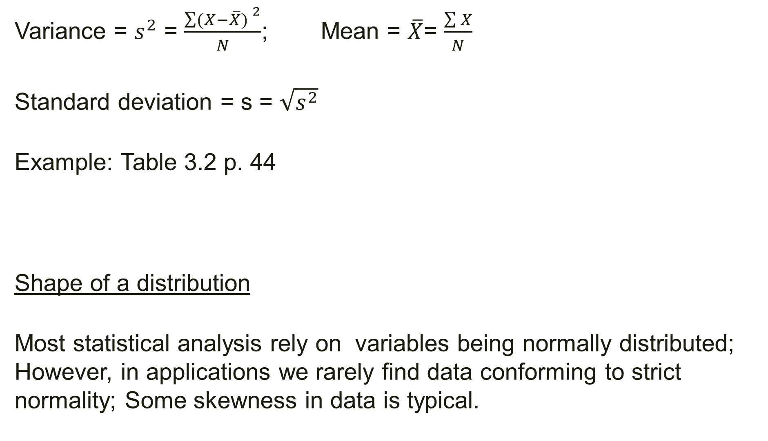
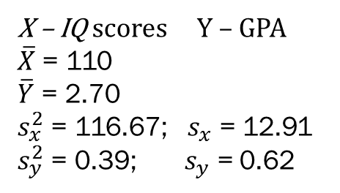
Variance = $s^{2}$ = $\frac{{\sum{(X−\overline{X}) }}^{2}}{N}$; Mean = $\overline{X}$= $\frac{\sum{X}}{N}$
Standard deviation = s = $\sqrt{s^{2}}$
Example: Table 3.2 p. 44
Shape of a distribution
Most statistical analysis rely on variables being normally distributed; However, in applications we rarely find data conforming to strict normality; Some skewness in data is typical.
X – IQ scores Y – GPA
$\overline{X}$ = 110
$\overline{Y}$ = 2.70
$s_{x}^{2}$ = 116.67; $s_{x}$ = 12.91
$s_{y}^{2}$ = 0.39; $s_{y}$ = 0.62

Slide 5
Association Between Distributions
Just as variance, covariance is also a very important concept.
Covariance is the degree to which two variables (distributions of scores) vary with respect to each other.
To examine covariance, each subject has to have scores on at least two variables. Example: IQ and GPA.
Two important pieces of information in covariance:
Direction of the association (relationship)
Magnitude of the association (relationship)

Slide 6
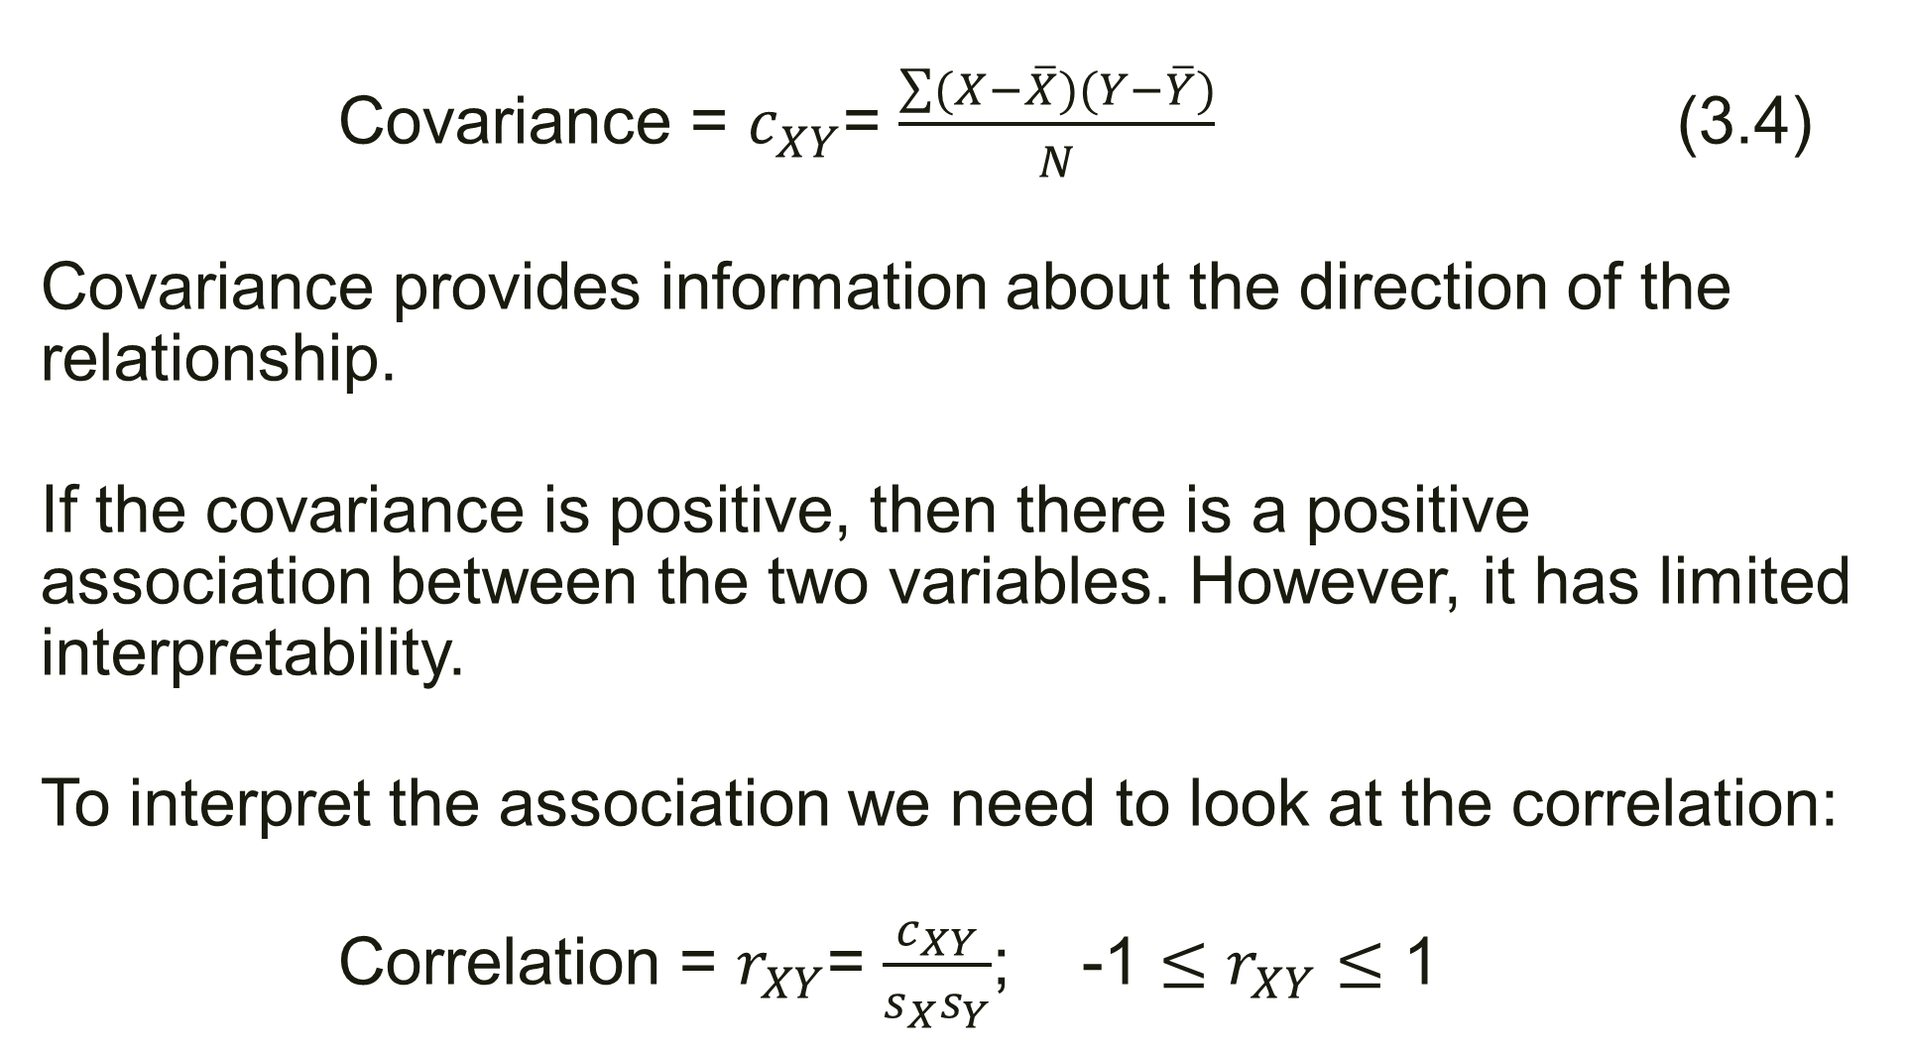
Covariance = $c_{XY}$= $\frac{\sum{(X−\overline{X})(Y−\overline{Y})}}{N}$ (3.4)
Covariance provides information about the direction of the relationship.
If the covariance is positive, then there is a positive association between the two variables. However, it has limited interpretability.
To interpret the association we need to look at the correlation:
Correlation = $r_{XY}$= $\frac{c_{XY}}{s_{X}s_{Y}}$; -1 $≤r_{XY}≤$ 1

Slide 7

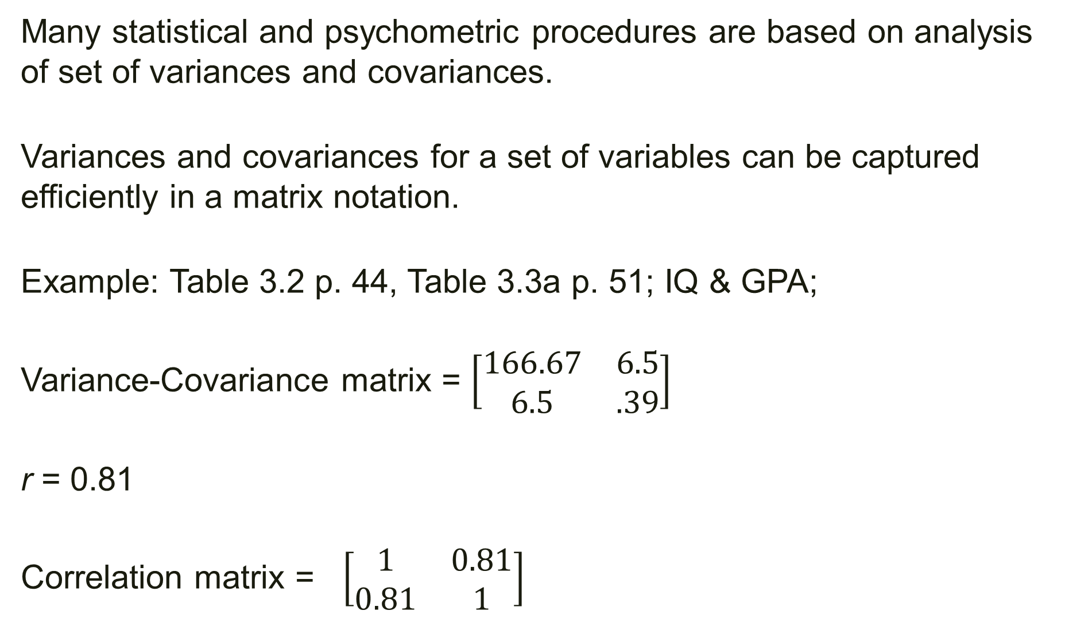
Many statistical and psychometric procedures are based on analysis of set of variances and covariances.
Variances and covariances for a set of variables can be captured efficiently in a matrix notation.
Example: Table 3.2 p. 44, Table 3.3a p. 51; IQ & GPA;
Variance-Covariance matrix = $\left[\begin{matrix}166.67 & 6.5 \\ 6.5 & .39\end{matrix}\right]$
r = 0.81
Correlation matrix = $\left[\begin{matrix}1 & 0.81 \\ 0.81 & 1\end{matrix}\right]$
X – IQ scores Y – GPA
$\overline{X}$ = 110
$\overline{Y}$ = 2.70
$s_{x}^{2}$ = 116.67; $s_{x}$ = 12.91
$s_{y}^{2}$ = 0.39; $s_{y}$ = 0.62
$c_{XY}$= $\frac{\sum{(X−\overline{X})(Y−\overline{Y})}}{N}$ = $\frac{39}{6}$=6.5
$r_{XY}$= $\frac{c_{XY}}{s_{X}s_{Y}}$=$\frac{6.5}{\left(12.91\right).62)}$ = 0.81

Slide 8

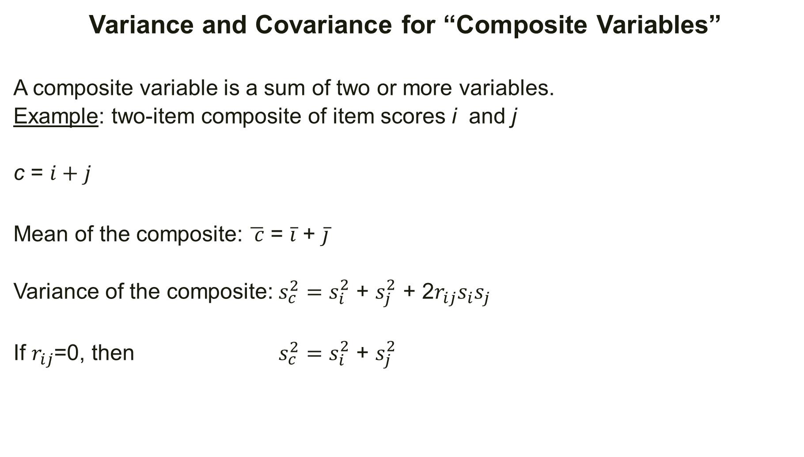
Variance and Covariance for “Composite Variables”
A composite variable is a sum of two or more variables.
Example: two-item composite of item scores i and j
c = $i+j$
Mean of the composite: $\overline{ c}$ = $\overline{i}$ + $\overline{j}$
Variance of the composite: $s_{c}^{2}=s_{i}^{2}$ + $s_{j}^{2}$ + 2$r_{ij}s_{i}s_{j}$
If $r_{ij}$=0, then $s_{c}^{2}=s_{i}^{2}$ + $s_{j}^{2}$
X - math y – verbal and
c = total = x+y
$\overline{X}$ = 20 $\overline{Y}$ = 30
$\overline{c}$ = 20+30 = 50
$s_{x}^{2}$ = 10; $s_{x}$ = 3.16
$s_{y}^{2}$ = 15; $s_{y}$ = 3.87
$r_{XY}$ = 0.5
$s_{c}^{2}$ = 10+15+(2x.5x3.16x3.87) = 37
$s_{c}$ = 6.08

Slide 9
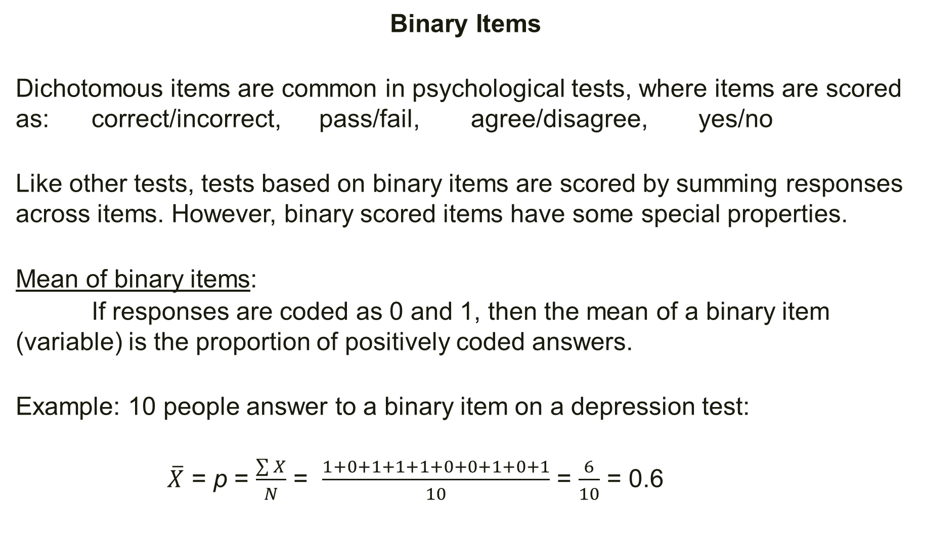
Binary Items
Dichotomous items are common in psychological tests, where items are scored as: correct/incorrect, pass/fail, agree/disagree, yes/no
Like other tests, tests based on binary items are scored by summing responses across items. However, binary scored items have some special properties.
Mean of binary items:
If responses are coded as 0 and 1, then the mean of a binary item (variable) is the proportion of positively coded answers.
Example: 10 people answer to a binary item on a depression test:
$\overline{X}$ = p = $\frac{\sum{X}}{N}$ = $\frac{1+0+1+1+1+0+0+1+0+1}{10}$ = $\frac{6}{10}$ = 0.6

Slide 10
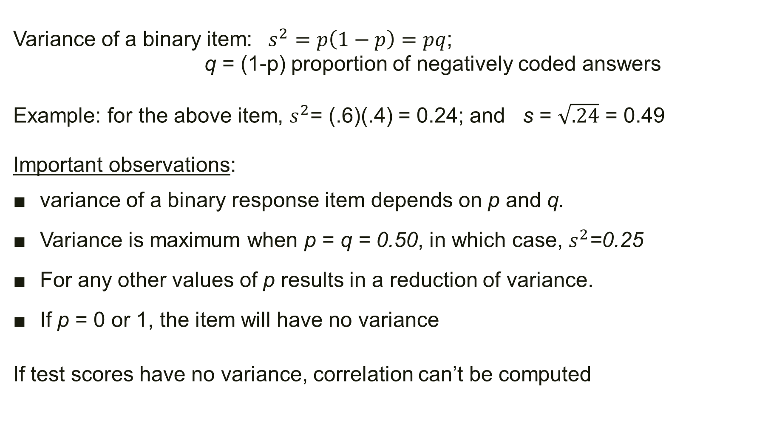
Variance of a binary item: $s^{2}=p\left(1−p\right)=pq$;
q = (1-p) proportion of negatively coded answers
Example: for the above item, $s^{2}$= (.6)(.4) = 0.24; and s = $\sqrt{.24}$ = 0.49
Important observations:
variance of a binary response item depends on p and q.
Variance is maximum when p = q = 0.50, in which case, $s^{2}$=0.25
For any other values of p results in a reduction of variance.
If p = 0 or 1, the item will have no variance
If test scores have no variance, correlation can’t be computed

Slide 11
Interpreting Test Scores
On most psychological tests, the “raw” score is not meaningful and not easily interpretable.
A “raw” score is a score obtained directly from the responses to test items.
Example: Number of correct responses; Number of “Agree” responses.
“Meaning” of test scores has two facets:
Basic meaning of a raw test score – relatively high or low
Psychological implications of test scores – question of validity

Slide 12
Interpreting the magnitude of test scores
When a person takes a test he/she receives a raw score:
# correct or percent correct
A score of 40 points on the test, what does it mean?
We need a frame of reference in order to interpret the test score.
In most cases the interpretive frame of reference is based on:
Mean (of the distribution of raw scores) -- does the raw score falls above or below the mean of the distribution? how far is the score from the mean?
Variability (within the distribution of raw scores) –a 5-point difference in a narrow distribution has a different meaning than a wide distribution.

Slide 13
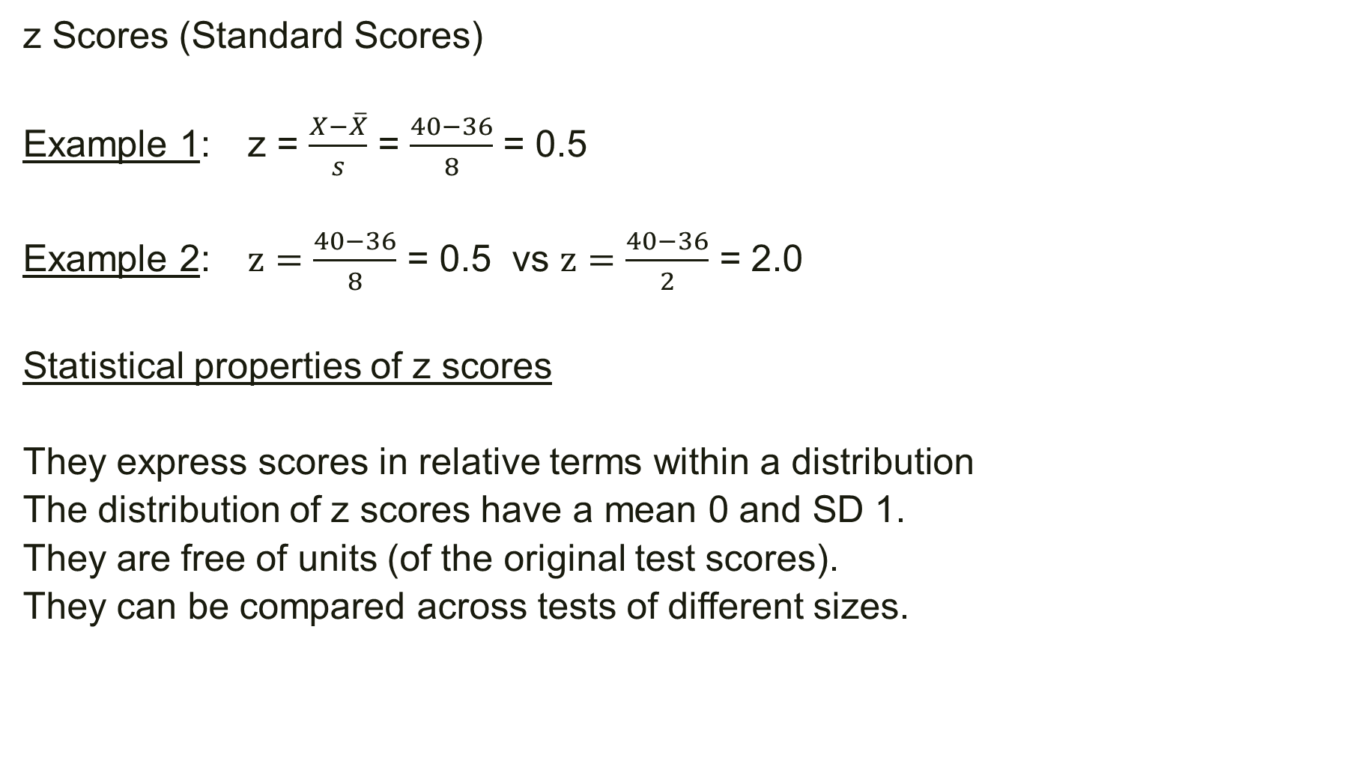
z Scores (Standard Scores)
Example 1: z = $\frac{X−\overline{X}}{s}$ = $\frac{40−36}{8}$ = 0.5
Example 2: $z=\frac{40−36}{8}$ = 0.5 vs $z=\frac{40−36}{2}$ = 2.0
Statistical properties of z scores
They express scores in relative terms within a distribution
The distribution of z scores have a mean 0 and SD 1.
They are free of units (of the original test scores).
They can be compared across tests of different sizes.

Slide 14
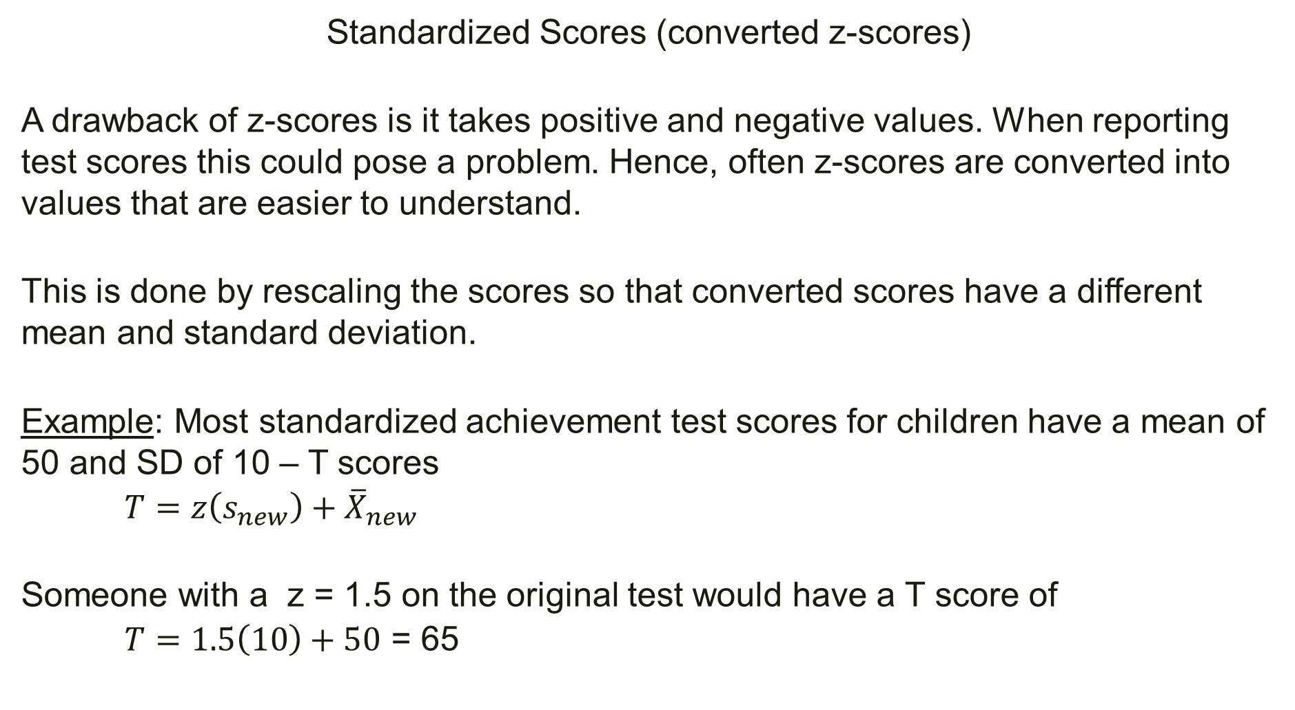
Standardized Scores (converted z-scores)
A drawback of z-scores is it takes positive and negative values. When reporting test scores this could pose a problem. Hence, often z-scores are converted into values that are easier to understand.
This is done by rescaling the scores so that converted scores have a different mean and standard deviation.
Example: Most standardized achievement test scores for children have a mean of 50 and SD of 10 – T scores
$T=z\left(s_{new}\right)+{\overline{X}}_{new}$
Someone with a z = 1.5 on the original test would have a T score of
$T=1.5\left(10\right)+50$ = 65

Slide 15
Normalized Scores
The process of correcting the discrepancy between the theory-based belief about the distribution of a psychological attribute and actual distribution of test data of the same attribute.
Example: It is believed that intelligence is normally distributed. But the actual test data from an IQ test may not be normally distributed.
Test developer’s assumptions:
The theory is correct.
Test data are imperfect reflection of the distribution of the construct.
One way to solve this problem is by transforming the imperfect (nonnormal) distribution of test scores into a distribution that approximates closely a normal distribution – normalization transformations.

Slide 16
Percentile Ranks
Percentage of scores that are below a specific test score.
Test Norms
Typically standardized tests are normed to facilitate their interpretation by test users.
During the test construction process it is administered to a large sample that is representative of the relevant population – reference sample.
Scores from the reference sample, “norms”, serve as a frame of reference for interpreting the scores of future test takers.

